Slide 1
Edison Arduino GPIO Mux
To make sense of this stuff you have to look at the schematics, datasheets, and these tables

Slide 2
REFS
https://theiotlearninginitiative.gitbooks.io/inteledison/content/documentation/PinMultiplexor.html
http://www.emutexlabs.com/project/215-intel-edison-gpio-pin-multiplexing-guide
file:///C:/u1404/intel-edison/Edison-Hardware-Refs/IntelAcademic_IoT-Edison_04_GPIO_on_Edison.pdf
http://intel-software-academic-program.com/courses/diy/Intel_Academic_-_DIY_-_InternetOfThings/

Slide 3
Edison Arduino Board GPIO Pin Usage Tracker
Digital Headers
J281
10 I2C SCL
9 I2C SDA
8 AREF
7 GND
6 IO13 --- SCK_GPIO \ Bit-Banged SPI Bus using fast memory mapped io
5 IO12 --- MISO_GPIO > Robogia encoder shied
4 IO11 --- MOSI_GPIO /
3 _IO10 -x- cut robogia shield pin (on bottom) & jmp to IO6 (on top)
2 / IO9 –-- csZ
1 | IO8 –-- csY
J181 |
8 | IO7 <<<< breaks Wifi, DO NOT USE
7 \_IO6 --- csX
6 IO5
5 IO4
4 IO3
3 IO2
2 IO1 → Uart(0) TxD \ Serial Interface to Kanagroo X2 MC
1 IO0 ← Uart(0) RxD /
Analog Header
6 IO19 – A5
5 IO18 – A4
4 IO17 – A3
3 IO16 – A2
2 IO15 – A1
1 IO14 – A0
AIO pins are treated as 0-5 in mraa_aio_init() but as 14-19 for everything else.
> Therefore use mraa_gpio_init(14) to use A0 as a GPIO

Slide 4
General Procedure
Configure IO5 as a GPIO input, with pull-up resistor disabled
# echo 13 > /sys/class/gpio/export 13 = GPIO # for IO5
# echo 253 > /sys/class/gpio/export 253 = GPIO # for Direction MUX U21
# echo 221 > /sys/class/gpio/export 221 = GPIO # for Pullup En/Disable
# echo 214 > /sys/class/gpio/export 214 = GPIO # to tristate pins while cfg-ing
# echo high > /sys/class/gpio/gpio214/direction
# echo low > /sys/class/gpio/gpio253/direction
# echo in > /sys/class/gpio/gpio221/direction
# echo mode0 > /sys/kernel/debug/gpio_debug/gpio13/current_pinmux
# echo in > /sys/class/gpio/gpio13/direction
# echo low > /sys/class/gpio/gpio214/direction
Export the pins you need to use
TriStateAll
Configure the pins
Un-TriStateAll

Slide 5
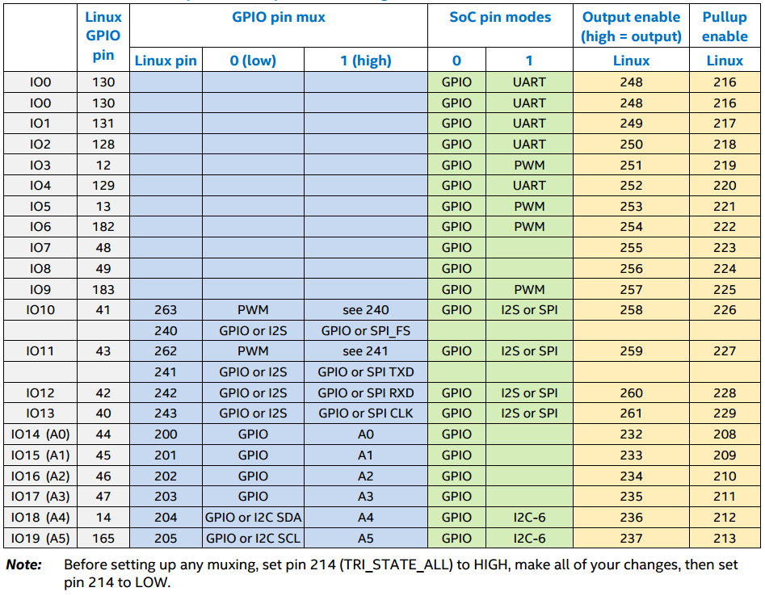
# echo modeX > /sys/kernel/debug/gpio_debug/gpioXX/current_pinmux
Linux GPIO Pin used to
a) cfg pin dir : echo “in” or “out” to /sys/class/gpio/gpioXX/direction
b) r/w the pin: echo –n “1” /sys/class/gpio/gpio48/value #(LED is on)
echo –n “0” /sys/class/gpio/gpio48/value # (LED is off)
PCAL9555
74LVCT45
mode0
mode1
mode2
47K pullup
“in” - input A<B
“out” – output A>B
“in” - pullup disabled
“out” – pullup enabled
Mux to control pin function
“low” or “high” to select
PIN DIR
MUX
Table1 Arduino* pin mux and pin mode settings

Slide 6
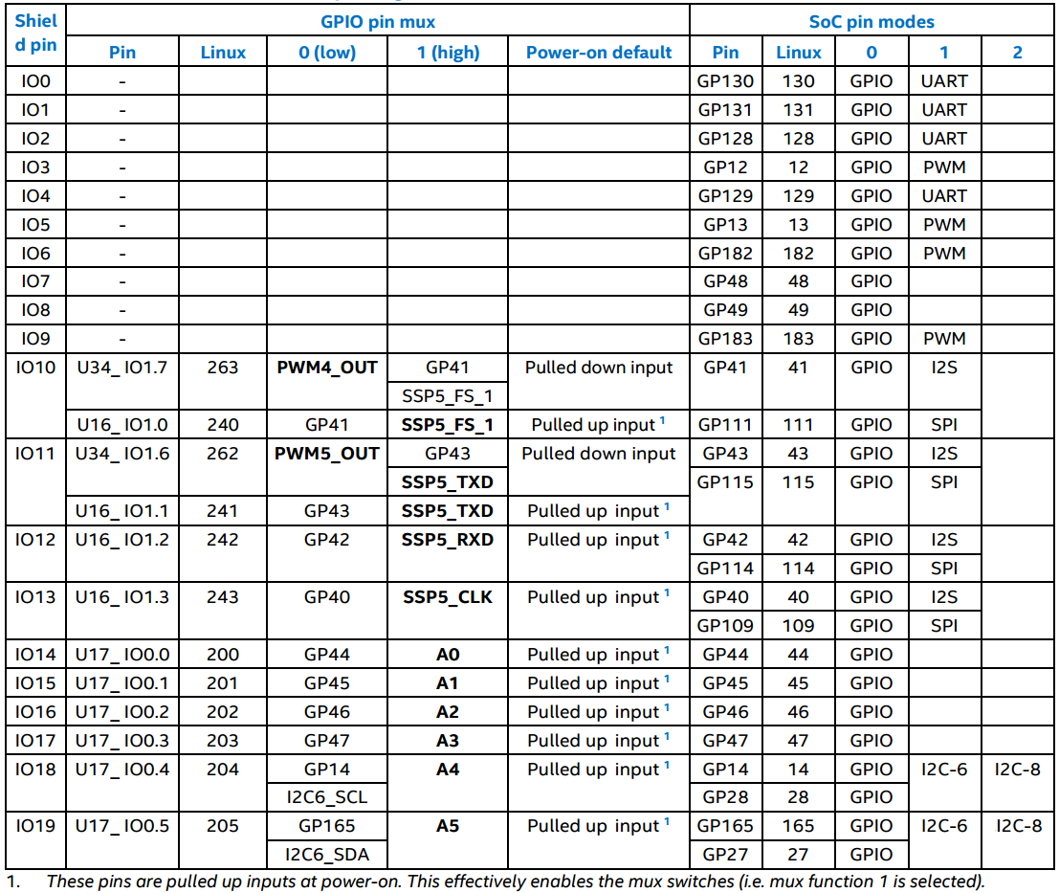
# echo mode0 > /sys/kernel/debug/gpio_debug/gpio13/current_pinmux
Table2 Pin Function Multiplexing Control
mode0 mode1 mode2

Slide 7
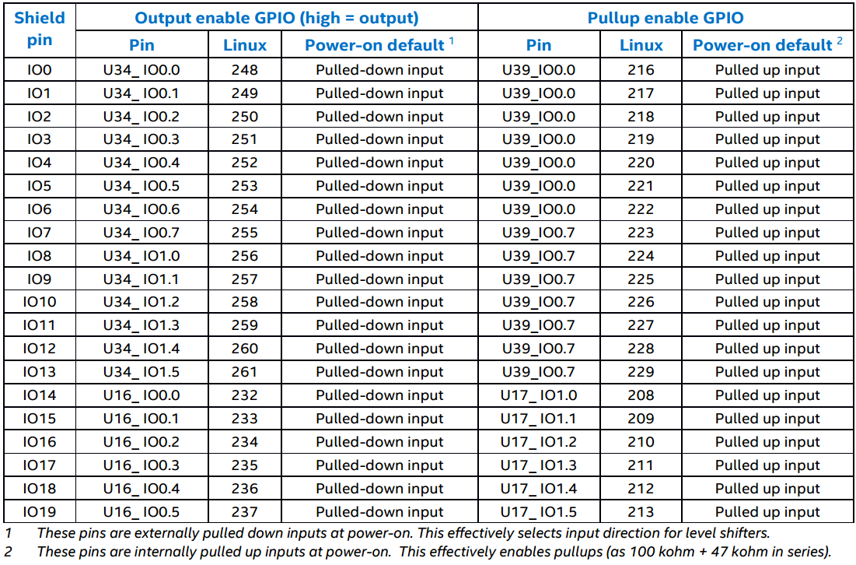
PCAL9555
74LVCT45
Pin #’s are
Incorrect
> See schematics
“in” - input A<B
“out” – output A>B
PIN DIR MUX(s)
Table3 Pin Direction and pull-up control

Slide 8
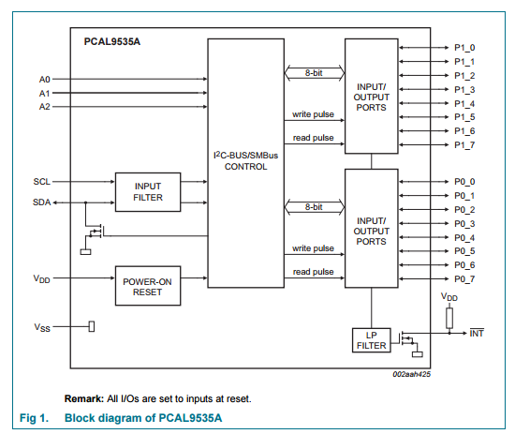
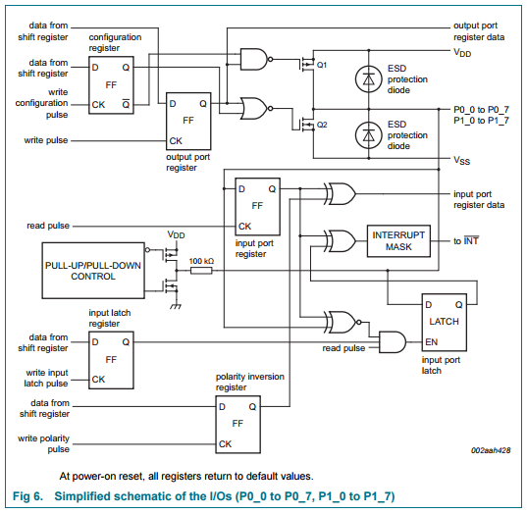
PCAL9555 & PCAL9535

Slide 9
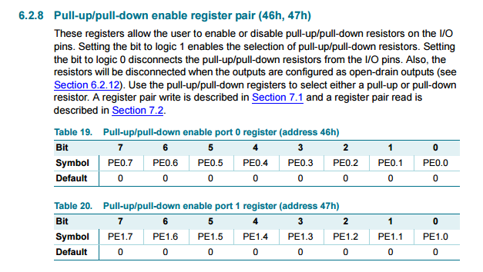
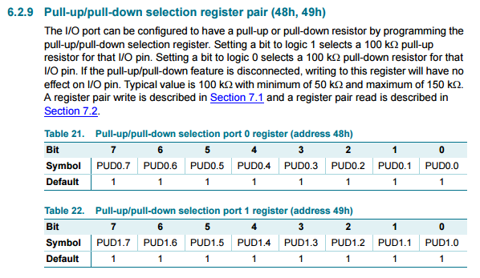
Pull UP / Pull Down Controls

Slide 10
Using mraa to configure gpio pins for OUTPUT:
Output
The mraa functions that you need to make use of a pin in output mode are very simple.
You need
mraa_gpio_init (mraa_pin) mraa_gpio_init_raw (SYSFS_gpiopin)
To set the pin up using either mraa number or SYSFS number.
You also need
mraa_gpio_dir (pin,dir)
to set the pin to output.
At its simplest dir is 0 for output and 1 for input but there is an enumeration you can use:
MRAA_GPIO_OUT = 0 MRAA_GPIO_IN = 1 MRAA_GPIO_OUT_HIGH = 2 MRAA_GPIO_OUT_LOW = 3
The last two, dir=2 and dir=3 set the line to output and initially high or low use if you need the line to be in a given state from the start.
The only other function that is specifically concerned with output is:
mraa_gpio_mode (pin, mode)
The output mode can be any of:
MRAA_GPIO_STRONG = 0 MRAA_GPIO_PULLUP = 1 MRAA_GPIO_PULLDOWN = 2 MRAA_GPIO_HIZ = 3
This works with the Arduino breakout board but not with the mini breakout. In this case the default is to use a 47K pull up resistor.
Finally we have:
mraa_gpio_write (pin, value)
which sets the line to high or low
Note that all of these functions make use of the SYSFS method of working with the GPIO. That is they are not interfacing directly with the GPIO driver.
SO: we can configure GPIO’s on edison arduino board with pullup or pulldown using libmraa
REF:
http://www.i-programmer.info/programming/hardware/8744-exploring-edison-mraa-gpio.html?start=1

Slide 11
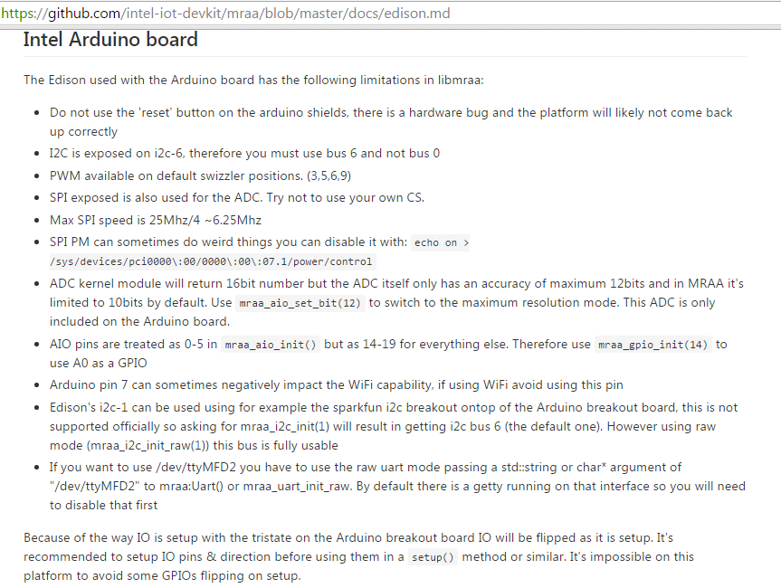
Using LIBMRAA to configure gpio pins on edsion arduino board

Slide 12
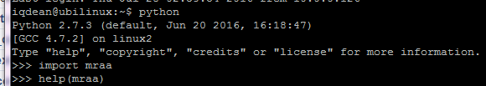
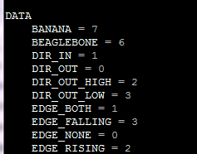

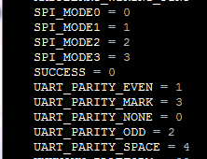
help(mraa)
https://learn.sparkfun.com/tutorials/installing-libmraa-on-ubilinux-for-edison
https://github.com/intel-iot-devkit/mraa/tree/master/examples/python
http://iotdk.intel.com/docs/master/mraa/python/

Slide 13
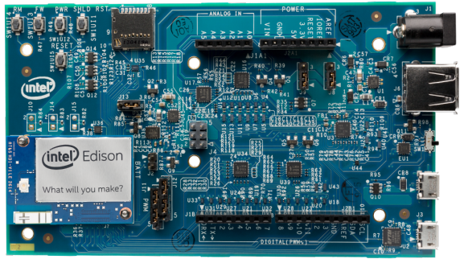
13 12 11 10 9 8 7 6 5 4 3 2 1 0
AIO 0 1 2 3 4 5
GPIO 14 15 16 17 18 19

